Slide 1
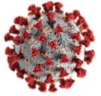
Setting the scene: case scenarios on anxiety and depression in the pandemic
Juan Mendive MD, PhD
Family Physician , Barcelona
La Mina Academic Primary Health Care Centre
WONCA Working Party on Mental Health (WWPMH) Treasurer
WWPMH Webinar , 25th October 2020

Slide 2
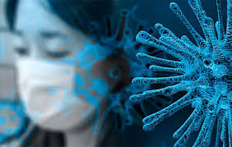
Covid 19 threats that impact mental health
Unknown virus behaviour
Uncertainty about own safety
Fears for family/friends
Bad news on news day to day
Feeling of lack of control
Feeling there is no end
....

Slide 3
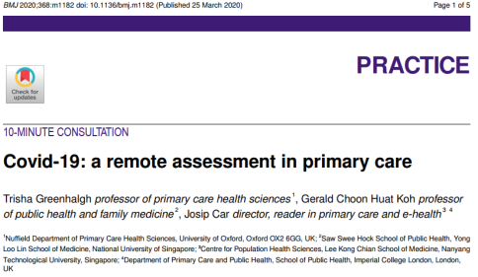
From protection to management, training & copying in primary care

Slide 4
Covid 19 and related scenarios in practice with psychological effects
People on long term management from primary care or mental health units
Difficulties in follow-up ( virtual or practice appointments)
Covid 19 inducing psychological/psychiatric sympthoms
People with new onset of mental health conditions because of difficulties/stress during the pandemic

Slide 5
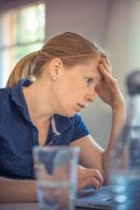
Isabel 45 years old
Divorced. Lives with mother and 2 sons
Working as secretary in an insurance company
Usually a bit of stress but coping with exercice and relaxation
A handicapped mother 84. Advanced osteoarthitis. Can’t move. Needs a person to look after her (caregiver several hours a day) .

Slide 6
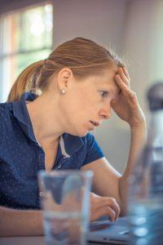
Isabel and pandemic
Insurance company send Isabel home for teleworking
Mother’s caregiver stops coming home for quarantine .
Isabel had to work and look after her mother .
Phoned me in practice after 3 weeks or so:
“ I can’t cope (in tears...) ...
Felt guilty and couldn’t sleep .
I sent her a sick leave form and provide her with emotional support and stress copying techniques.
Better after few weeks of follow-up.

Slide 7
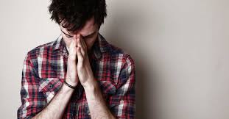
Fran 52 years old
Divorced and married again. Lives with second wife and her 2 sons.
Moved to Barcelona 2 years ago from another country. His only son remained there.
Lawyer working in a law firm.
Anxiety in the past when got divorced but stable now. Remembered having had phobic symptoms that made it difficult for him to leave home.

Slide 8
Fran and pandemic
When pandemic started he was sent home for teleworking.
At first started having fear, afterwards real panic of being infected. Impossible to think about going out.
When firm asked him to come back to work he coudn’t. Need for sick leave
Explain panic attack several times (short of breath and sleeping difficulties)
Put him on SSRI and follow-up visits (last one in practice)

Slide 9
Sofia 42 years old
Married and mother of one girl.
Working in a clothing store in Barcelona.
History of long term chronic depression but stable during the last 2 years.
Fibromyalgia diagnosed 2 years ago .
She doesn’t want psychopharmacology as “all pills make me feel bad”
She is active in yoga, mindfulness and physical exercise that help her a lot.
Usually follow-up visits in practice for providing emotional support.

Slide 10
Sofia and pandemic
Phoned me to ask for a face to face
appointment as things where going bad.
She explained starting feeling bad with the lock down. Felt depressive symptoms again ( mainly anhedonia, low mood, difficulty to sleep and loss of energy)
When going to work also general pain because of fibromyalgia and explaining feeling bad because of smelling hydroalcoholic liquids everywere.
Panic also of being infected . “ I can’t breath with the mask...”
Provide sick leave and non-pharmacological support with her agreement.

Slide 11
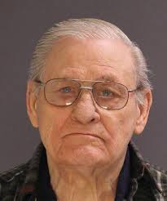
Jose 82 years old
Widower. Lives alone. Have 2 daughters
that live nearby and 5 grand children.
He used to go everyday to a community centre for elderly people where he joined other people/friends for activities and also had lunch.
Jose has advanced COPD and suffered a myocardial infarction 5 years ago. He is on different pills including treatment for hypertension, diabetes and pain relief tablets for advanced ostoeoartrithis.

Slide 12
Jose and the pandemic
The elderly centre closed.
Jose’s daughters and grandchildren could’t
visit him because of the risk of Covid infection.
On a follow-up telephone appointment he explained
being in a bad mood, felt down, had lost appetite and
coudn’t sleep well. He cried on the phoned saying
he should die to join his wife.
All that happened in spite of his daughters phoning him regularly and a social assistant was taking “meals on wheels” every day.
He was missing a lot his friends in the centre and contact with his family, especially his grandchildren.

Slide 13
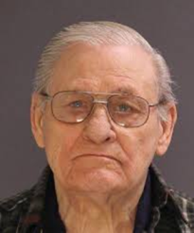
Jose and the pandemic (II)
He only remembered being like
that when his wife died.
He was put on a low dose SSRI and had a follow-up face to face appointment also to check cardiovascular profile.
In spite of a mild improvement of mood and that all cardiovascular profile was well controlled, he suffered a mild stroke some weeks afterwards. Hopefully he will recover well without deficiencies.

Slide 14
Holistic approach of Covid 10 and health impact
Anxiety , depression...
COVID 19
PSYCOLOGICAL
Covid , cardiovascular, cancer...
COVID 19
BIOLOGICAL
COVID 19
SOCIAL ( including family & community)
Isolation, loneliness...

Slide 15
Global Covid 19 impacts on mental health
Global health measures should be employed to address psychosocial stressors, particularly related to the use of isolation/quarantine, fear and vulnerability among the general population.
A worldwide inclusive response should include a focus on mental health impact of patients and general population.
The information from media and social network should be closely controlled and community supportive psychological interventions globally promoted.
Torales J, O'Higgins M, Castaldelli-Maia JM, Ventriglio A. The outbreak of COVID-19 coronavirus and its impact on global mental health. Int J Soc Psychiatry. 2020 Jun;66(4):317-320. doi: 10.1177/0020764020915212. Epub 2020 Mar 31. PMID: 32233719.

Slide 16
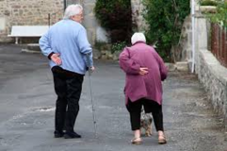
Primary Care & Mental Health in Covid
Need to follow up patients on risk ( already patients on depression and anxiety –mainly phobic disorders)
Need to follow up patients that had been suffering from Covid ( especially those after leaving hospital)
Need to follow up stressful conditions not well address because of lock down ( mourning for relatives or friends)
Be sure about own professional emotional and psychological situation and search for help if necessary

Slide 17
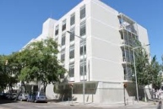
Resources for coping with Covid stress
Helplines for professionals ( different countries and global information –WHO-)
https://www.who.int/docs/default-source/coronaviruse/mental-health-considerations.pdf?sfvrsn=6d3578af_2
https://www.mhe-sme.org/what-we-do/covid-19-and-mental-health/
Webpages address to people to cope with Covid stress and symtoms related of anxiety and depression.
https://www.cdc.gov/coronavirus/2019-ncov/daily-life-coping/managing-stress-anxiety.html
https://headtohealth.gov.au/covid-19-support/covid-19
THANK YOU !!

Slide 18
Non-drug intervention (NDI) toolbox for psychological distress: What family doctors can do in a routine consultation
Weng Yee Chin
WONCA Working Party for Mental Health

Slide 19
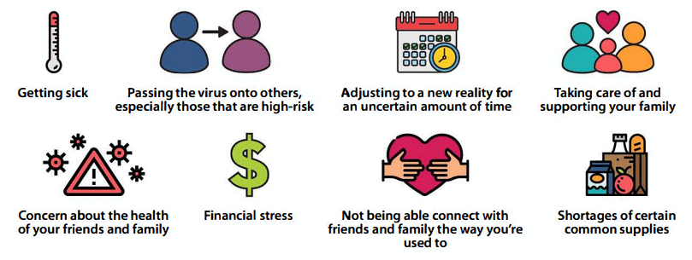
Mental health during COVID
Image Source: https://www.psychu.org/patient-caregiver/covid-19-your-mental-health/

Slide 20
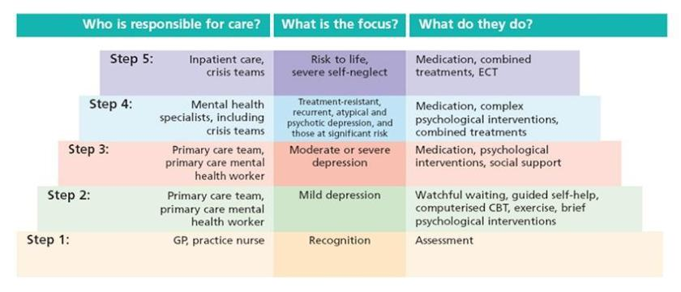
What can the family doctor do?
NDI’s
Image source: https://wellbeinginfo.org/self-help/mental-health/stepped-care/
Stepped Care Model - Two key principles:
Treatment should always have the best chance of delivering positive outcomes whilst minimizing the burden to the patient.
Scheduled reviews, to detect and act on non-improvement and to enable ‘stepping up’, ‘stepping down’ or ‘stepping out’.

Slide 21
NDI Toolbox for Family Doctors
Communication techniques and modified, brief evidence-based therapies
Trans-diagnostic (i.e. can be used for any type of common mental health disorder) with a primary focus on enhancing patient self-efficacy.
They can be effectively delivered by non mental health specialists including primary care doctors, nurses and trained lay-helpers.
https://www.globalfamilydoctor.com/site/DefaultSite/filesystem/documents/Groups/Mental%20Health/18%20Oct%20NDIs_updated.pdf

Slide 22
Expressing empathy & providing support and encouragement
Family doctors can engage (build a therapeutic alliance) with patients and to help alleviate psychological distress by showing adequate support and empathy
Through empathic listening
Providing positive affirmation (giving praise) e.g. “I can see how hard you are working”
Helping to reframe a problem (helping the patient see the ‘problem’ as an ‘opportunity’)
By use of ‘normalization’ (They’re not alone in this situation) – helps to validate their emotions
By facilitating the patient to ‘Let go’/ ‘Give in’ (let go of a grudge) e.g. “You’ve got to choose your battles, maybe this one’s not worth it"
By correcting misconceptions or mis-information
https://edhub.ama-assn.org/steps-forward/module/2702561

Slide 23
BATHE technique
Uses an interview format to allow the doctor to assess the background situation, the patient's affect, the problem that is most troubling for the patient and the way the patient is handling the problem and concludes with a response that conveys empathy.
Background: “What’s going on in your life?”
Affect: “How does that make you feel?” or “How has that affected you”
Trouble: “what troubles you about this?”
Handling “how are you handling that?”
Empathy “I imagine that could be / may be difficult” or “You seem to be going through a lot”
https://www.ncbi.nlm.nih.gov/pmc/articles/PMC181054/

Slide 24
Psychoeducation
refers to any educational intervention offered to individuals (and their families) to help empower them to improve their health.
Current evidence suggests that whilst the quality of psychoeducation provided is important, the method of delivery appears to be less important (e.g. patient information leaflets, face-to-face discussion, group-based classes).
Mind.org.uk
https://www.mind.org.uk/information-support/types-of-mental-health-problems/depression/about-depression/
https://www.mind.org.uk/information-support/types-of-mental-health-problems/anxiety-and-panic-attacks/about-anxiety/

Slide 25
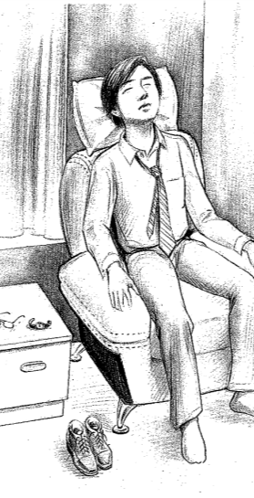
Relaxation Techniques
Examples:
slow breathing or diaphragmatic breathing exercises,
progressive muscle relaxation,
guided imagery or guided meditation
Mindfulness-Based Stress Reduction (MBSR).
Dr Grant Blashki’s GP training video on slow breathing exercises:
https://www.youtube.com/watch?v=aN05yXFbwI0

Slide 26
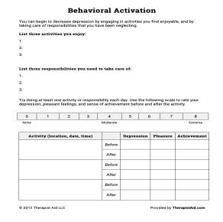
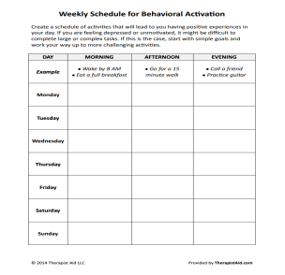
Behavioral Activation
a therapeutic process that emphasizes planned activities which help to increase behaviours that are likely to produce improvements in thoughts, mood, and overall quality of life.
It helps to enhance mood by reducing mood-worsening rumination whilst promoting positive reinforcing thoughts and feelings.
https://www.therapistaid.com/therapy-guide/behavioral-activation-guide

Slide 27
Exercise
Exercise (on its own or incorporated into an activity plan) should also be promoted routinely by GPs.
Cochrane review:
exercise is more effective than a placebo/ control for reducing symptoms of depression
as effective as psychological or pharmacological treatments.
Beneficial for depression even when it is light (yoga and stretching) as opposed to moderate and vigorous and when conducted once per week (Hallgren 2016).
Additional cardiovascular and metabolic benefits for patients with depression.
Example of free videos for exercising at home:
https://www.7minutemornings.com/

Slide 28
iCBT
A 2016 Cochrane review and 2020 systematic review:
iCBT interventions are effective
provides an important alternative to face-to-face psychological treatments
guided iCBT treatments (either with the GP or an allied health staff) are more effective than unguided treatments as it aids in adherence
So many online mental health resources available – how do you choose?
https://onemindpsyberguide.org/apps/

Slide 29
WONCA NDI Guidance & Toolkit
Dowrick, C. (Ed.). (2020). Global Primary Mental Health Care. London: Routledge, https://doi.org/10.4324/9780429026386
Available from the WONCA website in English, Spanish and Mandarin
https://www.globalfamilydoctor.com/groups/WorkingParties/MentalHealth3.aspx

Slide 30
ACKNOWLEDGEMENTS
The NDI guidance document was produced by a task group from the WONCA Working Party for Mental Health (WWPMH). The task group members were:
Dr Weng Yee Chin, Department of Family Medicine and Primary Care, University of Hong Kong
Professor Bruce Arroll, Department of General Practice and Primary Healthcare, University of Auckland, New Zealand.
Dr Juan Manuel Mendive, La Mina Academic Primary Health Care Centre, Barcelona, Spain.
Dr Donald Nease, Department of Family Medicine, University of Colorado, USA.
Dr Jinan Usta, Department of Family Medicine, American University of Beirut, Lebanon.
Professor Samuel Wong, Department of Family Medicine and Primary Care, University of Hong Kong.
Professor Christopher Dowrick, Department of Psychological Sciences, University of Liverpool, UK.
The group received valuable comments from: Dr Evelyn van Weel-Baumgarten (President, International Association for Communication in Healthcare), Dr Henk Parmentier (Secretary, World Federation for Mental Health), Professor Gabriel Ivbijaro (President, World Federation for Mental Health), Professor Helen Hermann (President, World Psychiatric Association) and Dr Tarun Dua (WHO Mental Health Directorate).

Slide 31
Any Questions?
Dr Weng Yee CHIN
Email me on: chinwy@hku.hk

Slide 32
Physical Health Care of People with Severe Mental Illness1
Kim Griswold MD, MPH
Alan Cohen, MD

Slide 33
“COVID-19…require(s) primary care to hold on to its goal of parity of esteem between physical and mental health and find ways to identify, counsel and support patients in the months ahead.” 2

Slide 34
Serious Mental Illness
Diagnosis of schizophrenia, bipolar disorder, or other psychotic disorder is implied.
Disability is significant.
Duration of the disorder is usually at least 2 years.
Notes:
This is particularly important for people with SMI.

Slide 35
An imperative: Millennium Sustainable Goal 3
“Reduce premature mortality from non-communicable diseases through prevention and treatment, and promote mental health and well-being.”

Slide 36
Pandemic effects on mental health:3
Decreased access to care, medications.
Increased symptomatology.
Increased incidence of anxiety, PTSD, depression.
Rise in substance use.

Slide 37
Pandemic effects on physical health: 4,5
Reduction in care management for DM, HTN, COPD.
Decreased access to care.
Decrease in rates of testing for LDL cholesterol and HbA1c.
Decline in new medication prescriptions (statins and metformin).

Slide 38
The Family Doctor and Team
Often provide front line care to people with Serious Mental Illness (SMI).
Have heightened awareness of COVID-19 effects on physical and mental health.
Remain the pillars of robust primary care systems.
Are needed more than ever for their expertise in preventive care.

Slide 39
“Primary health care is the foundation of health and wellbeing at every stage of life.”6
Essential for mental health care.
Safety net for vulnerable populations.
Foundation for ensuring equity in care.

Slide 40
“Family doctors empower the systems through training and new modes of practice”7 Remain the gatekeepers for optimum physical and psychological care.
Notes:
As Dr. Li reminds us,

Slide 42
They Came Like Swallows William Maxwell
“They came like swallows and like swallows went, And yet a woman’s powerful character Could keep a swallow to its first intent;
And half a dozen in formation there, That seemed to whirl upon a compass point, Found certainty upon the dreaming air…”
W.B.Yeats Coole Park

Slide 43
References:
1.Cohen A, Griswold K. Physical Health Care of People with SMI. In: Global Primary Mental Health Care. Ed. Christopher Dowrick. Routledge. WONCA. 2020.
2.Williams S, Tsiligianni I. COVID-19 poses novel challenges for global primary care. Primary Care Respiratory Medicine. 2020.
https://doi.org/10.1038/s41533-020-0187-x
3.Torales J, O’Higgins M, Castaldelli-Maia JM, Ventriglio A. The Outbreak of COVID-19 Coronavirus and its Impact on Global Mental Health. IJSP. 2020.
4.Wright A, Salazar A, Mirica M, et al. The Invisible Epidemic: Neglected Chronic Disease Management During COVID-19. JGIM. 35(9):2816-7.
DOI: 10.1007/s11606-020-06025-4
Notes:
From equality with “equal footing” to Equity, where everyone can achieve!

Slide 44
References:
5.Chudasama YV, Gillies CL, Zaccardi F, et al. Impact of COVID-19 on routine care for chronic diseases: A global survey of views from healthcare professionals. Diabetes and Metabolic Syndrome: Clinical Research and Reviews. 2020. https://doi.org/10.1016/j.dsx.2020.06.042
6.Primary Healthcare Performance Initiative. PHCPI. 2020. Key Messages. https://improvingphc.org/
7.Li DKT. Challenges and Responsibilities of Family Doctors in the new global coronavirus outbreak. Fam Med and Community Health. 2020;8:e000333. doi:10.1136/
fmch-2020-000333
8. They Came Like Swallows. William Maxwell Harper and Bros., New York, 1937.
9. Coole Park, W.B. Yeats, 1929.
Notes:
From equality with “equal footing” to Equity, where everyone can achieve!

Slide 45
Building resilience to adversity
A/Prof Jill Benson AM
Adelaide, Australia
Secretary, WONCA Working Party on Mental Health

Slide 46
The pandemic from the doctor’s perspective
Stress is when the outside circumstances are too overwhelming for our personal resources
Uncertainty and chaos
Insufficient training, PPE, resources, guidelines
TIME
Fear, guilt, loneliness, conflict, stigma
Family vs work
Changing roles and finances

Slide 47
The problem
>70% of healthcare workers in Australia said Covid restrictions have had a negative effect on the wellbeing and family life as well as in the workplace
This can increase risk of decreased quality of care, mental health disorders, substance misuse, burnout, even suicide
Most have not sought support from mental health workers or even friends or family
About half have actively increased steps to maintain good mental health

Slide 48
The 5 principles of self-care

Slide 49
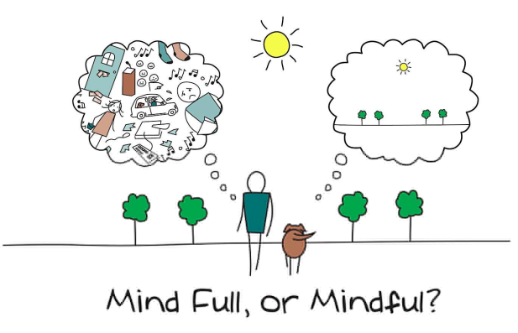
Preparation
Sleep, diet, exercise
Meditation or mindfulness (eg Headspace, Calm apps)
Decrease exposure to social media and news
Friends, laughter, pets
Gratitude

Slide 50
Protection
‘Your mother is not here. The person you see inside this room is not your mother. It is a doctor working saving lives. She can perform no parental functions of any type for the time being (unless it is an emergency). Please do not disturb her until this notice is removed from the door’.
PPE, Flu vaccine, masks
Find a way to put a boundary between work and home life, particularly if you are doing telehealth from home
Increase social connectedness eg Balint group, singing online

Slide 51
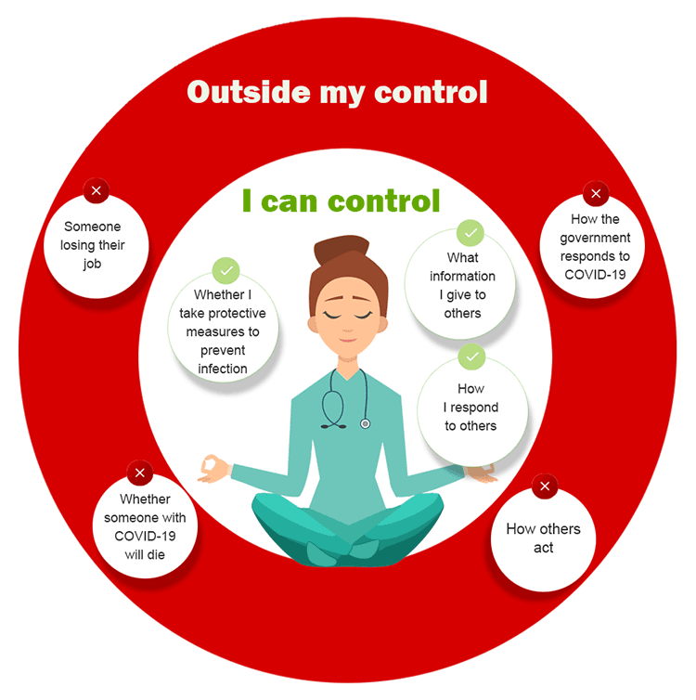
Professionalism
Evidence-based information
‘Growth mindset’
Remember that hopelessness is also infectious
Know your limits
Stay home if you’re sick

Slide 52
Promote hope, self-efficacy & care for others
We are leaders and role models
Maintain core values
Practice self-compassion
Ensure our staff and colleagues are okay
Find your tribe

Slide 53
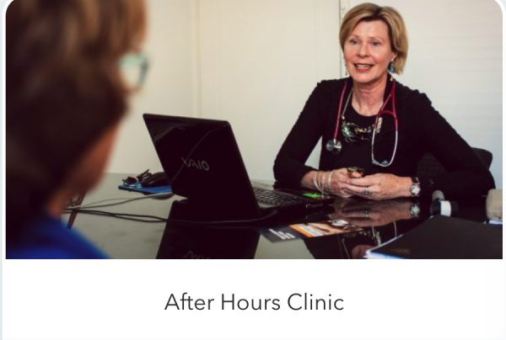
Pathway of care
Have your own GP who knows how to be a doctor for doctors
Find someone you are confident to confide in
Know how to advocate for your own wellbeing in the system

Slide 54
Conclusion
For many doctors in the world, this crisis is the first time we have had to deal with severe disruption to our personal and professional lives.
For others, this adds to already stretched resources, compassion and resilience. We need to care for ourselves and our colleagues as we are also at risk of ‘post-corona stress disorder’
Hopefully, on the other side we will more aware of the importance of our relationships and our small objects of gratitude.
We will find new strength, meaning and courage in ourselves and have a deeper awareness and respect for our collective resilience.

Slide 55
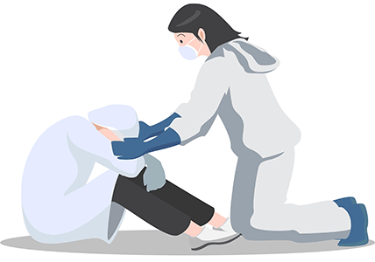
Resources and thanks
http://www.emro.who.int/mhps/frontline_worker.html
https://www.drs4drs.com.au/
https://moodgym.com.au
https://www.beyondblue.org.au/
WONCA Working Party on Mental Health & Doctors Health SA
Benson J, Sexton R, Gibson C, Lionis C, Ferriera Velosa Gomes J, Bakola M, Al-Khathami A, Nazeer S, Igoumenaki A, Usta J, Arroll B, van Weel-Baumgarten E, Allen C, Dowrick C

